Slide 1
Advanced JavaScript & JQuery
Chapter 15

Slide 2
Objectives
1
2
JavaScript Pseudo-Classes
jQuery Foundations
3
4
AJAX
Asynchronous File Transmission
5
6
Animation
Backbone MVC Frameworks
7

Slide 3
JavaSCript Pseudo-Classes
Section 1 of 6

Slide 4
Object Oriented Design
Without Classes
JavaScript has no formal class mechanism.
Many common features of object-oriented programming, such as inheritance and even simple methods, must be arrived at through these nonintuitive means.
These “strange” techniques give JavaScript a bad reputation, but can easily be mastered.

Slide 5
Using Object Literals
Without Classes
An object can be instantiated using object literals.
Object literals are a list of key-value pairs with colons between the key and value with commas separating key-value pairs.
Object literals are also known as Plain Objects in jQuery.

Slide 6
Using Object Literals
Consider a die (single dice)
//define a 6 faced dice, with a red color.
var oneDie = { color : "FF0000",
faces : [1,2,3,4,5,6]
};
These elements can be accessed using dot notation.
For instance, one could change the color to blue by writing:
oneDie.color="0000FF";

Slide 7
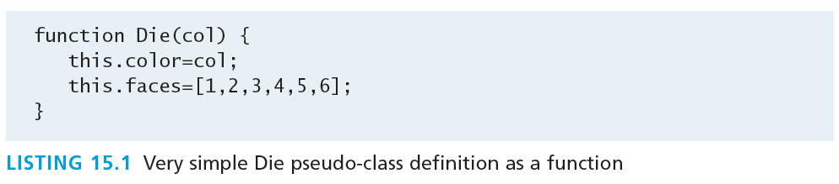
Emulate Classes with functions
We told you this would get weird
It is possible to mimic many features of classes by using functions to encapsulate variables and methods together.
Instantiation looks much like in PHP:
var oneDie = new Die("0000FF");

Slide 8
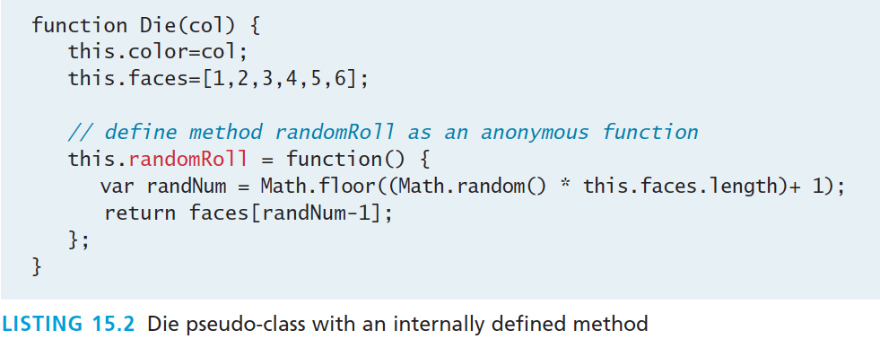
Emulate Classes with functions
Add methods to the object – mimic methods
One technique for adding a method inside of a class definition is by assigning an anonymous function to a variable
var oneDie = new Die("0000FF"); console.log(oneDie.randomRoll() + " was rolled");

Slide 9
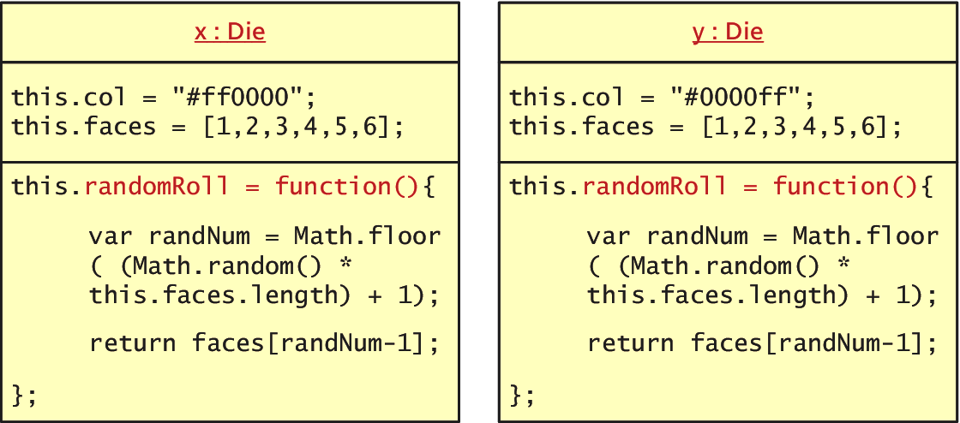
Emulate Classes with functions
Not very efficient
Defining methods as we have shown is not a memory-efficient approach because each inline method is redefined for each new object!

Slide 10
Using Prototypes
Prototypes
A better approach is to define the method just once using a prototype of the class.
Prototypes are used to make JavaScript behave more like an object-oriented language.
The prototype properties and methods are defined once for all instances of an object.
Every object has a prototype

Slide 11
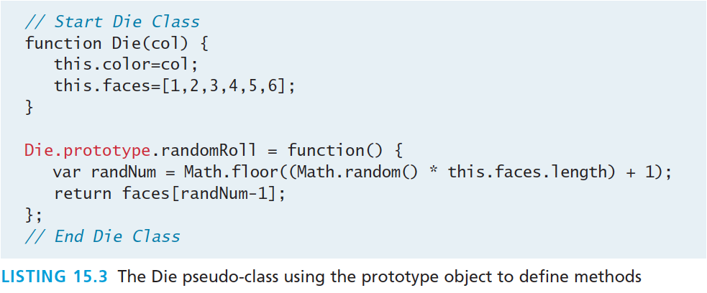
Using Prototypes
moving the randomRoll() function into the prototype.

Slide 12
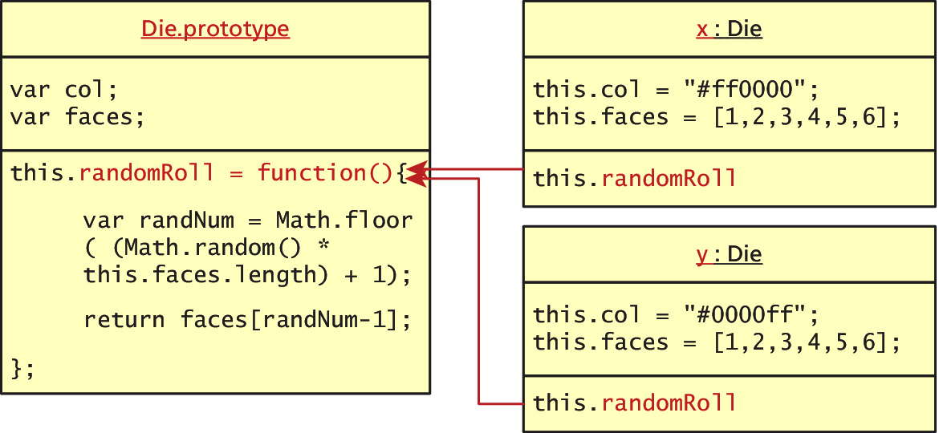
Using Prototypes
No duplication of methods
Since all instances of a Die share the same prototype object, the function declaration only happens one time and is shared with all Die instances.

Slide 13
More about Prototypes
There’s more?
It should be known that every object (and method) in JavaScript has a prototype.
A prototype is an object from which other objects inherit.
The above definition sounds almost like a class in an object-oriented language, except that a prototype is itself an object, not an abstraction

Slide 14
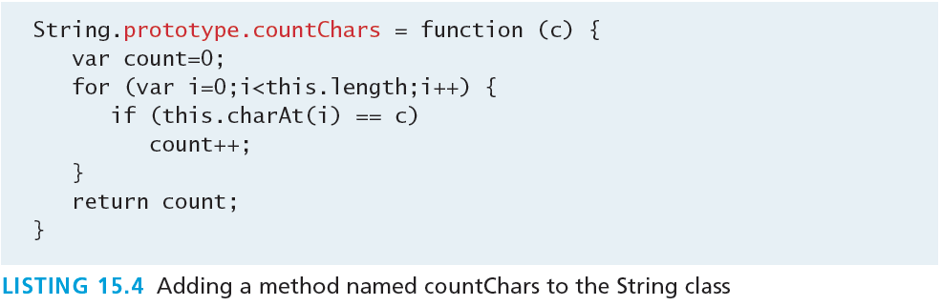
More about Prototypes
Extend any Object
In addition to using prototypes for our own pseudo-classes, prototypes enable you to extend existing classes by adding to their prototypes!
Below we extend String:

Slide 15
More about Prototypes
Extending String, for example
Now any new instances of String will have this method available to them while existing strings will not.
Now we can use the new method in all new Strings.
The following example will output
Hello World has 3 letter l's.
var hel = new String("Hello World”); console.log(hel + "has" + hel.countChars("l") + " letter l's");

Slide 16
jQuery Foundations
Section 2 of 6

Slide 17
jQuery
Framework
A library or framework is software that you can utilize in your own software, which provides some common implementations of standard ideas.
Many developers find that once they start using a framework like jQuery, there’s no going back to “pure” JavaScript because the framework offers so many useful shortcuts and succinct ways of doing things

Slide 18
jQuery
A 1 slide history
In August 2005 jQuery founder John Resig was looking into how to better combine CSS selectors with succinct JavaScript notation.
Within 1 year AJAX and animations were added
Additional modules
jQuery UI extension
mobile device support
Continues to improve.

Slide 19
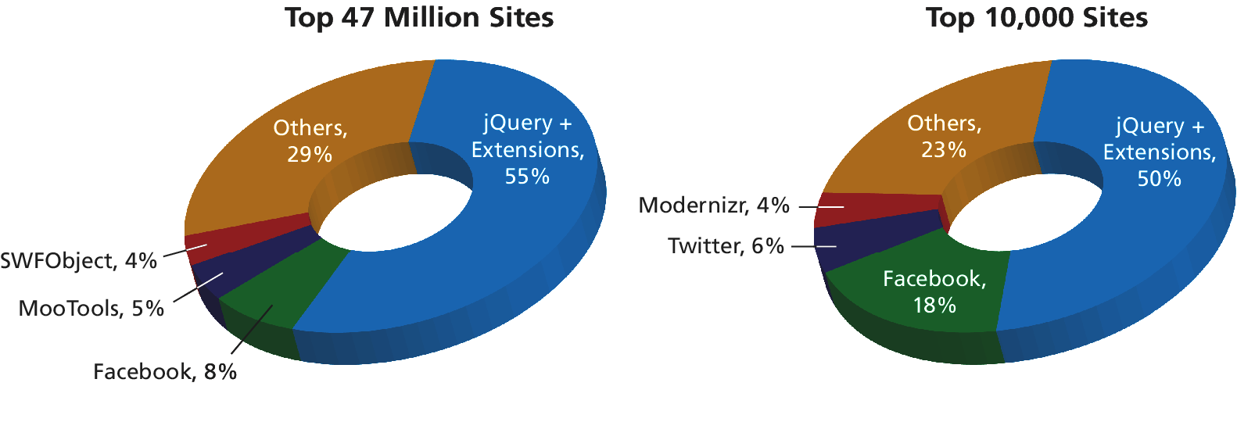
jQuery
Not the only one, but a popular one
jQuery is now the most popular JavaScript library currently in use as supported by the statistics from BuiltWith.com

Slide 20
Including jQuery
Let’s get started
You must either:
link to a locally hosted version of the library
Use an approved third-party host, such as Google, Microsoft, or jQuery itself

Slide 21
Including jQuery
Content Delivery Network
Using a third-party content delivery network (CDN) is advantageous for several reasons.
The bandwidth of the file is offloaded to reduce the demand on your servers.
The user may already have cached the third-party file and thus not have to download it again, thereby reducing the total loading time.
A disadvantage to the third-party CDN is that your jQuery will fail if the third-party host fails (unlikely but possible)

Slide 22
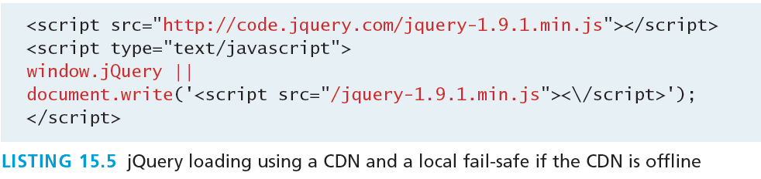
Including jQuery
Content Delivery Network and fallback

Slide 23
jQuery Selectors
Should ring a bell
When discussing basic JavaScript we introduced the getElementByID() and querySelector() selector functions in JavaScript.
Although the advanced querySelector() methods allow selection of DOM elements based on CSS selectors, it is only implemented in newest browsers
jQuery introduces its own way to select an element, which under the hood supports a myriad of older browsers for you!

Slide 24
jQuery Selectors
The easiest way to select an element yet
The relationship between DOM objects and selectors is so important in JavaScript programming that the pseudo-class bearing the name of the framework,
jQuery()
Is reserved for selecting elements from the DOM.
Because it is used so frequently, it has a shortcut notation and can be written as
$()

Slide 25
Basic Selectors
All the way back to CSS
The four basic selectors are:
$("*") Universal selector matches all elements (and is slow).
$("tag") Element selector matches all elements with the given element name.
$(".class") Class selector matches all elements with the given CSS class.
$("#id") Id selector matches all elements with a given HTML id attribute.

Slide 26
Basic Selectors
All the way back to CSS
For example, to select the single <div> element with id="grab" you would write:
var singleElement = $("#grab");
To get a set of all the <a> elements the selector would be:
var allAs = $("a");
These selectors replace the use of getElementById() entirely.

Slide 27
More CSS Selectors
jQuery’s selectors are powerful indeed
In addition to these basic selectors, you can use the other CSS selectors that were covered in Chapter 3 on CSS:
attribute selectors,
pseudo-element selectors, and
contextual selectors

Slide 28
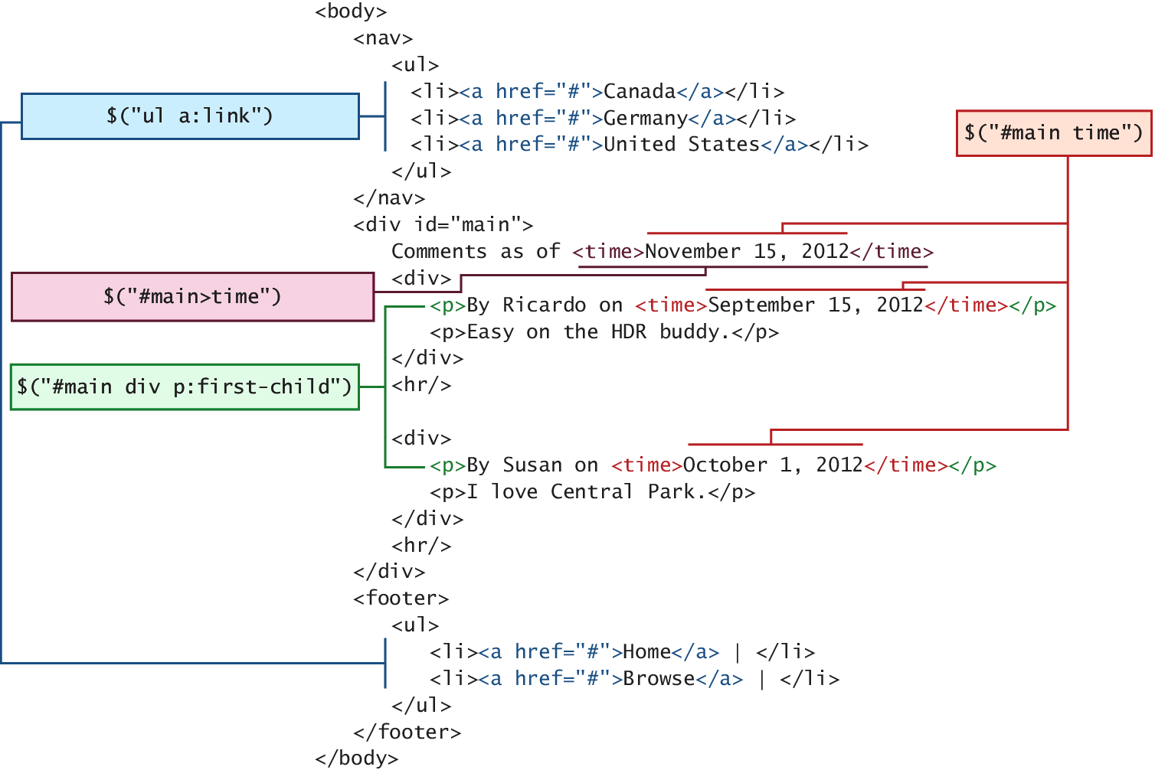
More CSS Selectors
jQuery’s selectors are powerful indeed

Slide 29
Attribute Selector
Really a review of CSS
Recall from CSS that you can select
by attribute with square brackets
[attribute]
Specify a value with an equals sign
[attribute=value]
Search for a particular value in the beginning, end, or anywhere inside a string
[attribute^=value]
[attribute$=value]
[attribute*=value]

Slide 30
Attribute Selector
Really a review of CSS
Consider a selector to grab all <img> elements with an src attribute beginning with /artist/ as:
var artistImages = $("img[src^='/artist/']");

Slide 31
Pseudo-Element Selector
Not to be confused with the pseudo-classes in JavaScript
pseudo-element selectors are also from CSS and allow you to append to any selector using the colon and one of
:link
:visited
:focus
:hover
:active
:checked
:first-child, :first-line, and :first-letter

Slide 32
Pseudo-Element Selector
Not to be confused with the pseudo-classes in JavaScript
Selecting all links that have been visited, for example, would be specified with:
var visitedLinks = $("a:visited");

Slide 33
Contextual Selector
Put it into context
Contextual selectors are also from CSS. Recall that these include:
descendant (space)
child (>)
adjacent sibling (+)
and general sibling (~).
To select all <p> elements inside of <div> elements you would write
var para = $("div p");

Slide 34
Content Filters
Above and Beyond CSS
The content filter is the only jQuery selector that allows you to append filters to all of the selectors you’ve used thus far and match a particular pattern.
Select elements that have:
a particular child using :has()
have no children using :empty
match a particular piece of text with :contains()

Slide 35
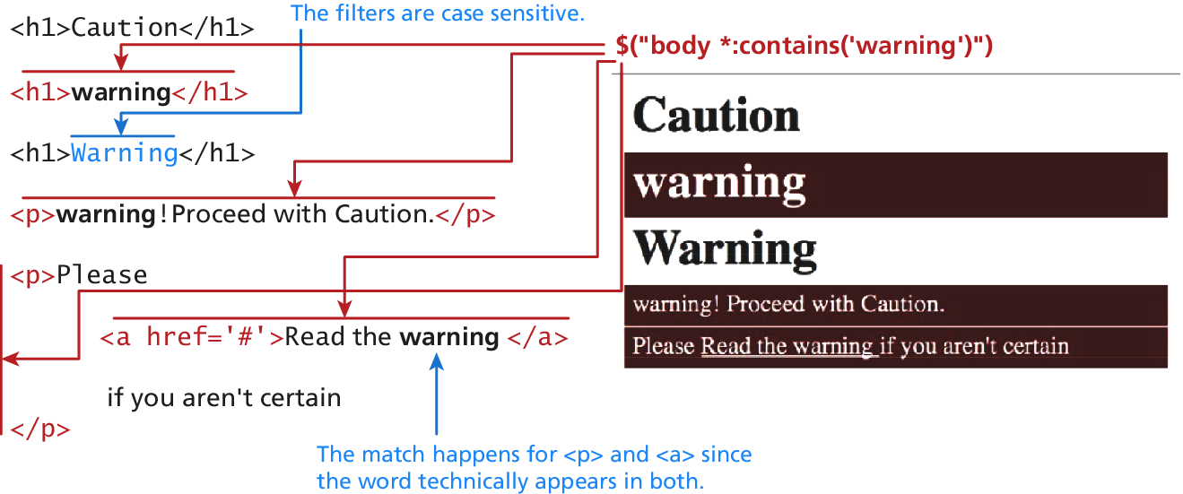
Content Filters
Above and Beyond CSS
$("body *:contains('warning')”)

Slide 36
Form Selectors
[m1]Au: I HAVEN’T TAGGED COMMAS IN THESE LISTS. Please check other lists in this table below.
Above and Beyond CSS
Selector | CSS Equivalent | Description
$(:button) | $("button, input[type='button']") | Selects all buttons
$(:checkbox) | $('[type=checkbox]‘) | Selects all checkboxes
$(:checked) | No Equivalent | Selects elements that are checked. This includes radio buttons and checkboxes.
$(:disabled) | No Equivalent | Selects form elements that are disabled.
$(:enabled) | No Equivalent | Opposite of :disabled
$(:file) | $('[type=file]') | Selects all elements of type file
$(:focus) | $( document.activeElement ) | The element with focus
$(:image) | $('[type=image]') | Selects all elements of type image
$(:input) | No Equivalent | Selects all <input>, <textarea>, <select>, and <button> elements.
$(:password) | $('[type=password]') | Selects all password fields
$(:radio) | $('[type=radio]') | Selects all radio elements
$(:reset) | $('[type=reset]') | Selects all the reset buttons
$(:selected) | No Equivalent | Selects all the elements that are currently selected of type <option>. It does not include checkboxes or radio buttons.
$(:submit) | $('[type=submit]') | Selects all submit input elements
$(:text) | No Equivalent | Selects all input elements of type text. $('[type=text]') is almost the same, except that $(:text) includes <input> fields with no type specified.

Slide 37
jQuery Attributes
Back to HTML now.
In order to understand how to fully manipulate the elements you now have access to, one must understand an element’s attributes and properties.
The core set of attributes related to DOM elements are the ones specified in the HTML tags.
The href attribute of an <a> tag
The src attribute of an <img>
The class attribute of most elements

Slide 38
jQuery Attributes
And some examples
In jQuery we can both set and get an attribute value by using the attr() method on any element from a selector.
// var link is assigned the href attribute of the first <a> tag var link = $("a").attr("href");
// change all links in the page to http://funwebdev.com $("a").attr("href","http://funwebdev.com");
// change the class for all images on the page to fancy $("img").attr("class","fancy");

Slide 39
HTML Properties
Full circle
Many HTML tags include properties as well as attributes, the most common being the checked property of a radio button or checkbox.
The prop() method is the preferred way to retrieve and set the value of a property although, attr() may return some (less useful) values.
<input class ="meh" type="checkbox" checked="checked">
Is accessed by jQuery as follows:
var theBox = $(".meh"); theBox.prop("checked"); // evaluates to TRUE theBox.attr("checked"); // evaluates to "checked"

Slide 40
Changing CSS
With jQuery
jQuery provides the extremely intuitive css() methods.
To get a css value use the css() method with 1 parameter:
$color = $("#colourBox").css("background-color"); // get the color
To set a CSS variable use css() with two parameters: the first being the CSS attribute, and the second the value.
// set color to red $("#colourBox").css("background-color", "#FF0000");

Slide 41
Shortcut Methods
With jQuery
The html() method is used to get the HTML contents of an element. If passed with a parameter, it updates the HTML of that element.
The val() method returns the value of the element.
The shortcut methods addClass(className) / removeClass(className) add or remove a CSS class to the element being worked on. The className used for these functions can contain a space-separated list of classnames to be added or removed.
The hasClass(classname) method returns true if the element has the className currently assigned. False, otherwise.

Slide 42
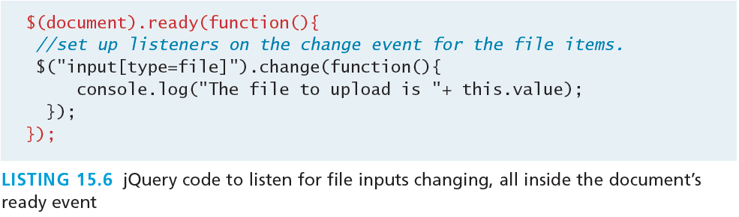
jQuery Listeners
Set up after page load
In JavaScript, you learned why having your listeners set up inside of the window.onload() event was a good practice.
With jQuery we do the same thing but use the $(document).ready() event

Slide 43
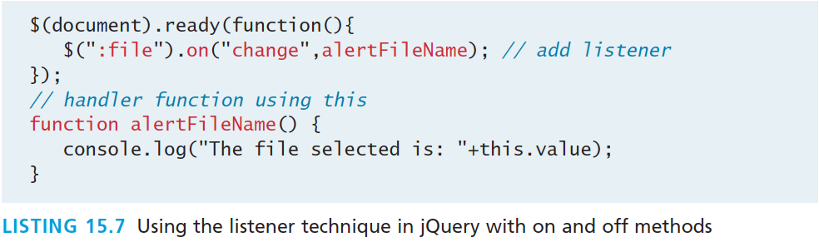
jQuery Listeners
Listener Management
While pure JavaScript uses the addEventListener() method, jQuery has on() and off() methods as well as shortcut methods to attach events.

Slide 44
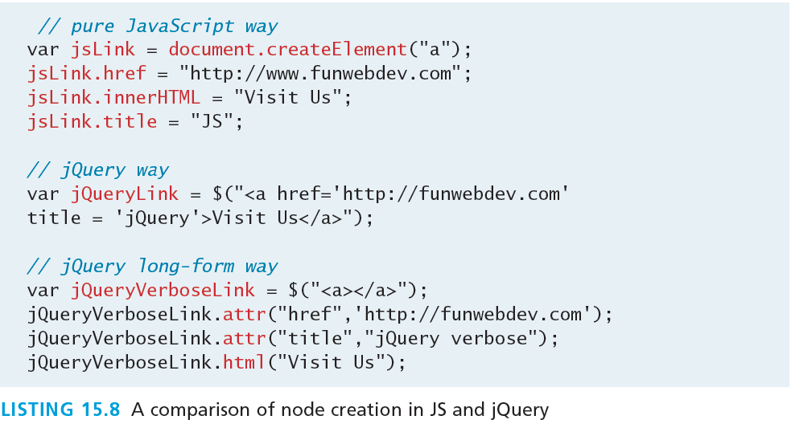
Modifying the DOM
Creating Nodes

Slide 45
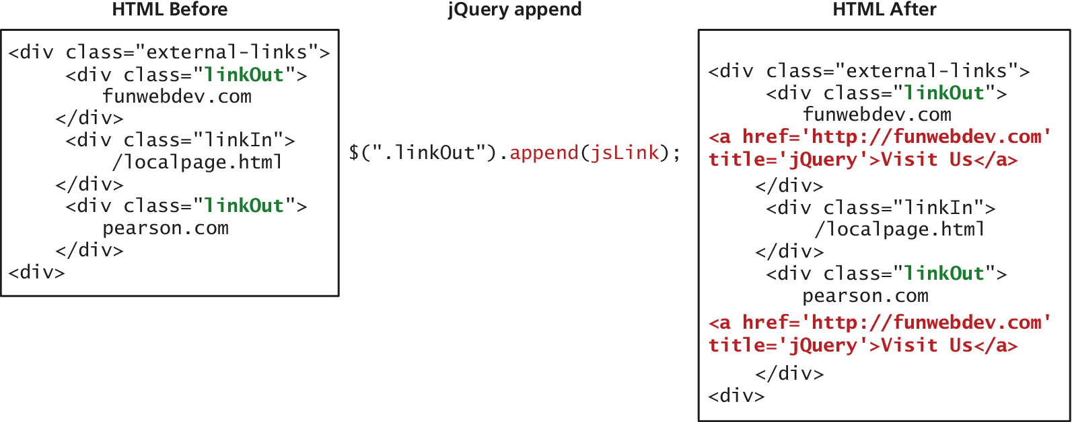
Modifying the DOM
Appending DOM Elements
The append() method takes as a parameter an HTML string, a DOM object, or a jQuery object. That object is then added as the last child to the element(s) being selected.

Slide 46
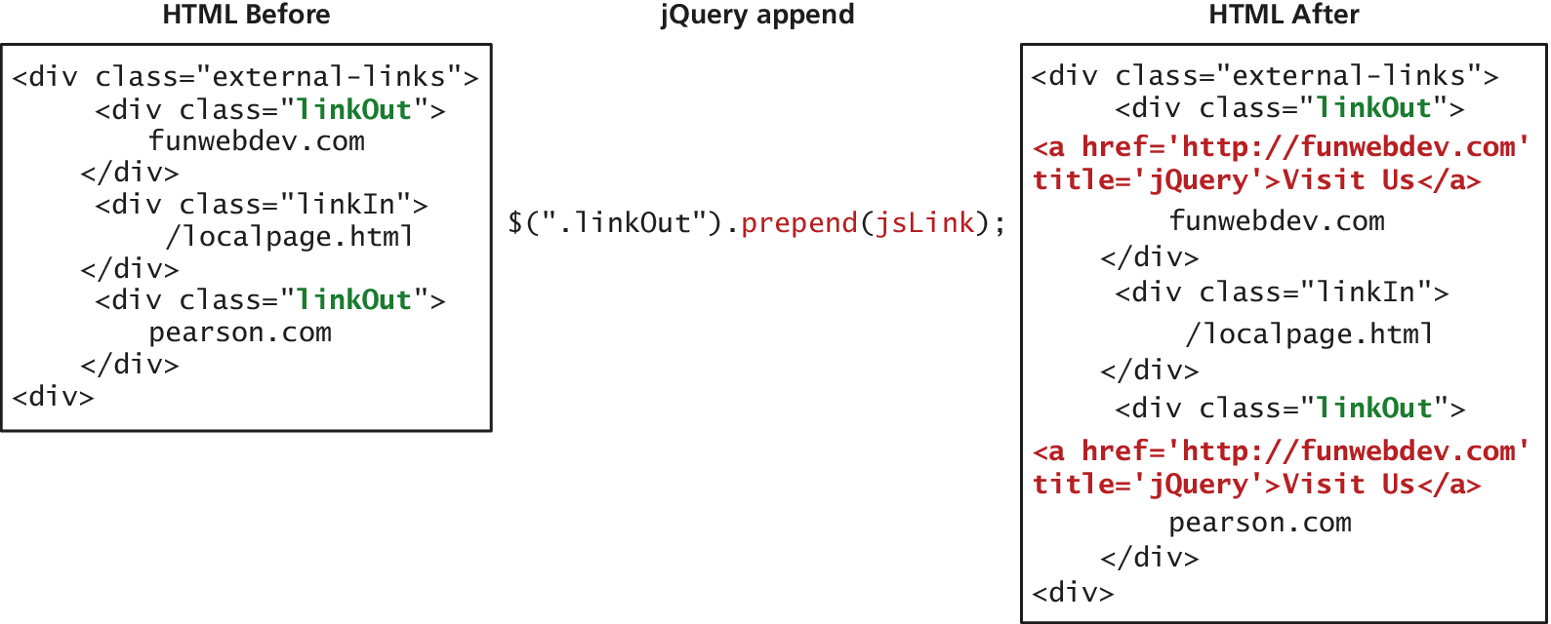
Modifying the DOM
Prepending DOM Elements
The prepend() and prependTo() methods operate in a similar manner except that they add the new element as the first child rather than the last.

Slide 47
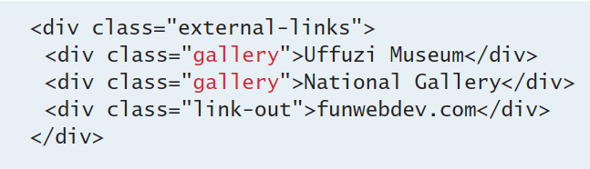
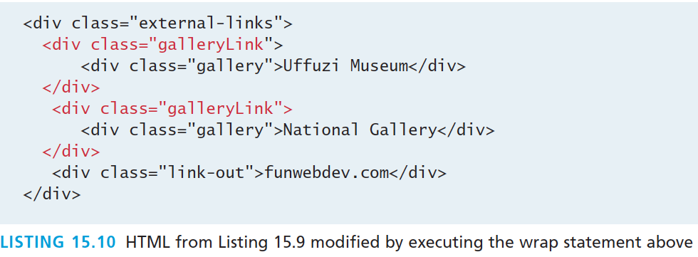
Modifying the DOM
Wrapping Existing DOM in New Tags
$(".gallery").wrap('<div class="galleryLink"/>');

Slide 48
Modifying the DOM
Wrapping Existing DOM in New Tags
A more advanced technique might make use of the content of each div being modified. In that case we use a callback function in place of a simple element.
The wrap() method is a callback function, which is called for each element in a set (often an array).
Each element then becomes this for the duration of one of the wrap() function’s executions, allowing the unique title attributes as shown in Listing 15.12.

Slide 49
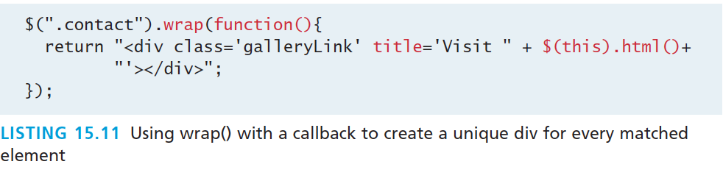
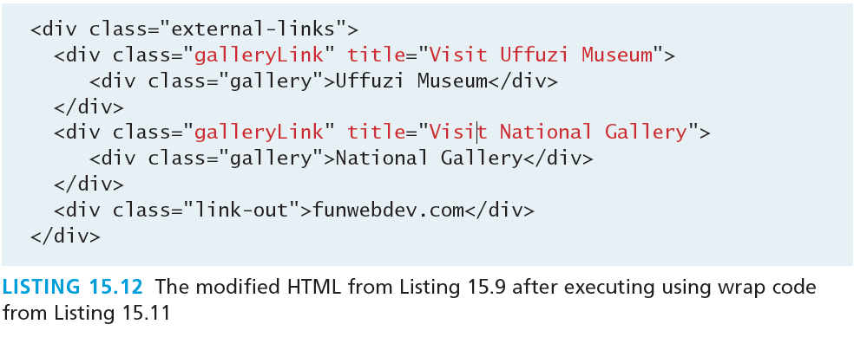
Modifying the DOM
Wrapping Existing DOM in New Tags

Slide 50
AJAX
Section 3 of 6

Slide 51
AJAX
Asynchronous JavaScript with XML
Asynchronous JavaScript with XML (AJAX) is a term used to describe a paradigm that allows a web browser to send messages back to the server without interrupting the flow of what’s being shown in the browser.

Slide 52
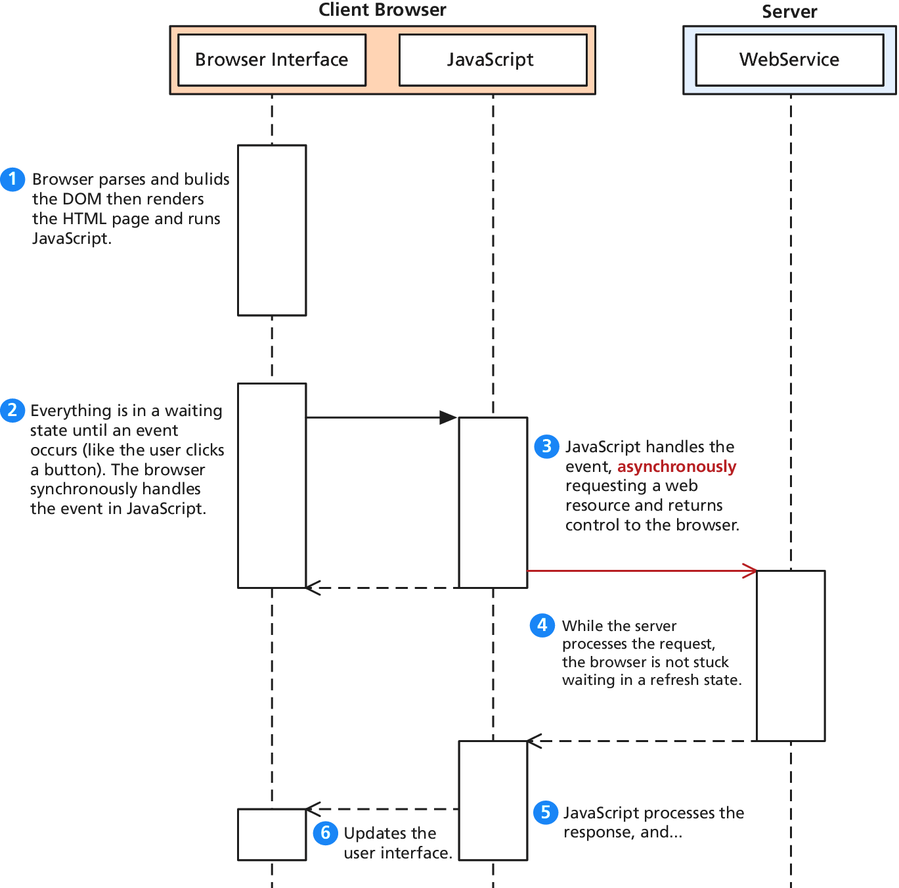
AJAX
UML of an asynchronous request

Slide 53
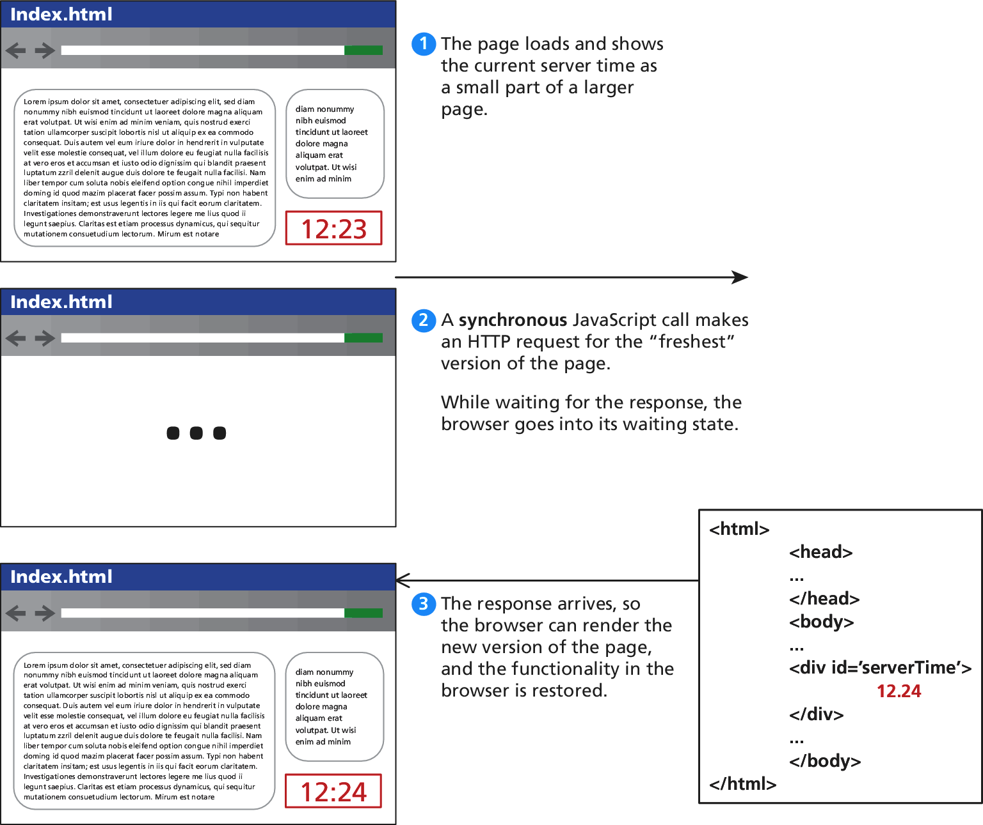
AJAX
Consider a webpage that displays the server’s time

Slide 54
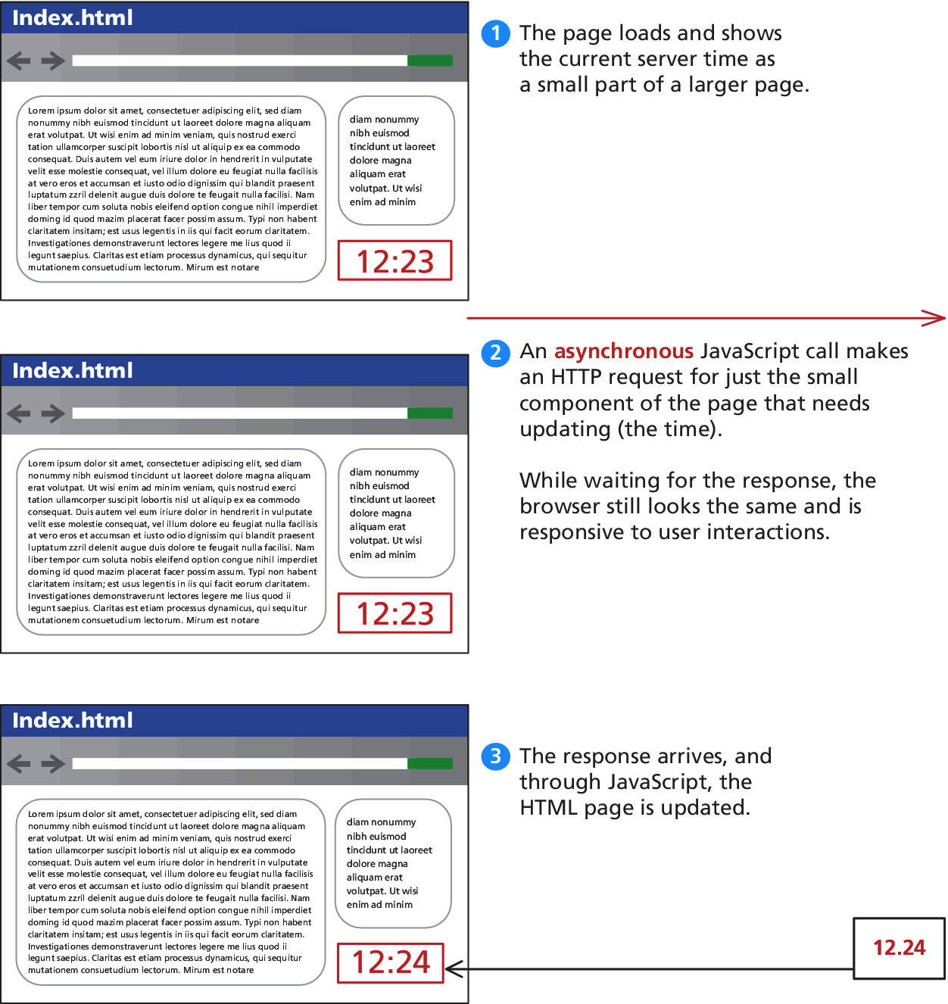
AJAX
Consider a webpage that displays the server’s time

Slide 55
AJAX
Making Asynchronous requests
jQuery provides a family of methods to make asynchronous requests. We will start simple and work our way up.
Consider the very simple server time example we just saw. If currentTime.php returns a single string and you want to load that value asynchronously into the <div id="timeDiv"> element, you could write:
$("#timeDiv").load("currentTime.php");

Slide 56
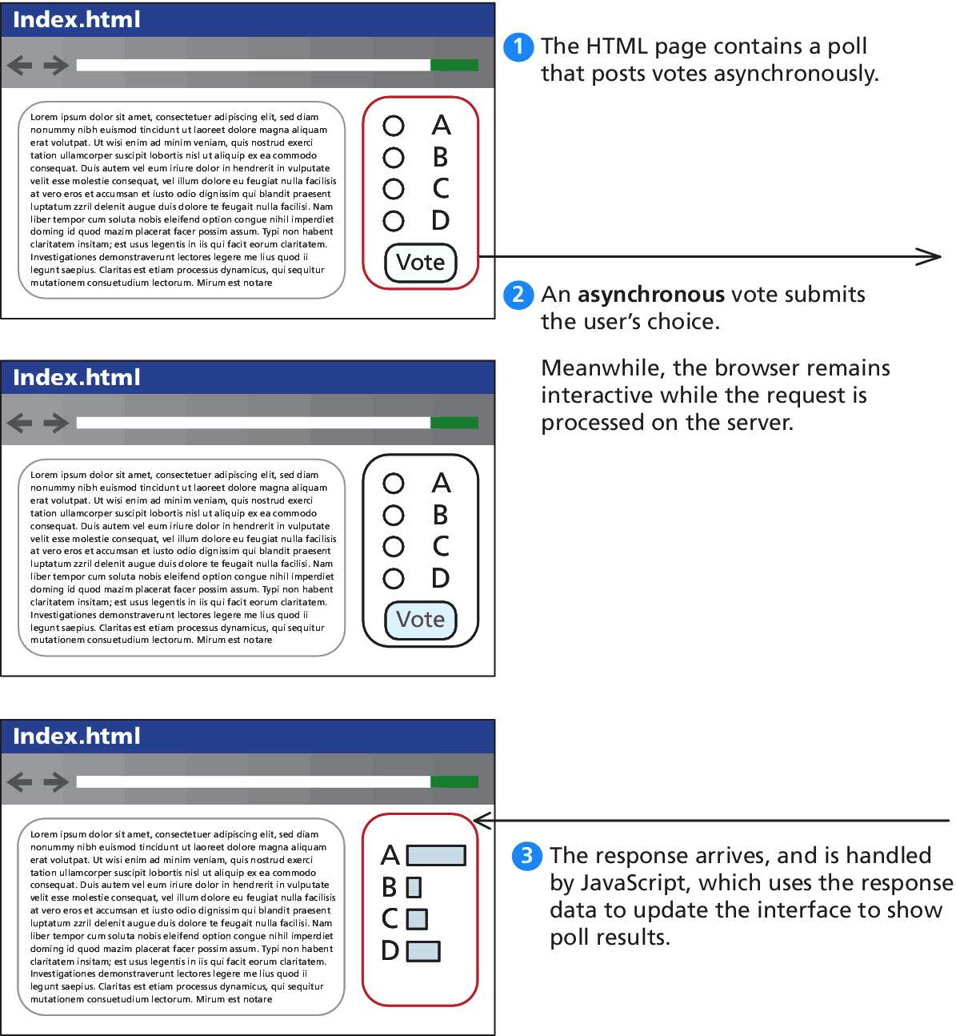
AJAX
GET Requests
$.get("/vote.php?option=C");

Slide 57
AJAX
GET Requests – formal definition
jQuery.get ( url [, data ] [, success(data, textStatus, jqXHR) ] [, dataType ] )
url is a string that holds the location to send the request.
data is an optional parameter that is a query string or a Plain Object.
success(data,textStatus,jqXHR) is an optional callback function that executes when the response is received.
data holding the body of the response as a string.
textStatus holding the status of the request (i.e., “success”).
jqXHR holding a jqXHR object, described shortly.
dataType is an optional parameter to hold the type of data expected from the server.

Slide 58
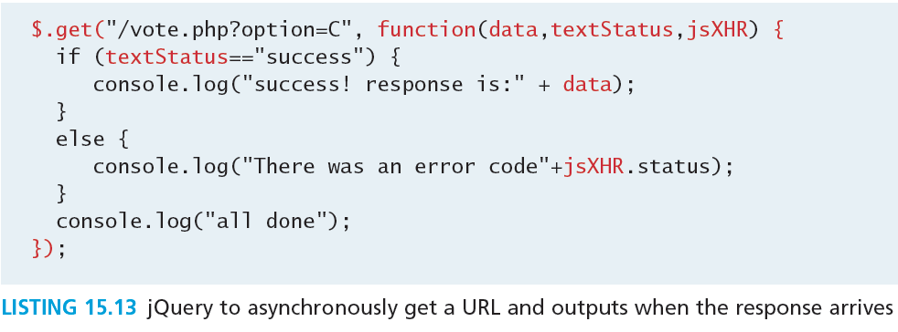
AJAX
GET Requests – an example

Slide 59
AJAX
The jqXHR Object
All of the $.get() requests made by jQuery return a jqXHR object to encapsulate the response from the server.
In practice that means the data being referred to in the callback from Listing 15.13 is actually an object with backward compatibility with XMLHttpRequest.

Slide 60
AJAX
jqXHR - XMLHttpRequest compatibility
abort() stops execution and prevents any callback or handlers from receiving the trigger to execute.
getResponseHeader() takes a parameter and gets the current value of that header.
readyState is an integer from 1 to 4 representing the state of the request. The values include 1: sending, 3: response being processed, and 4: completed.
responseXML and/or responseText the main response to the request.
setRequestHeader(name, value) when used before actually instantiating the request allows headers to be changed for the request.
status is the HTTP request status codes (200 = ok)
statusText is the associated description of the status code.

Slide 61
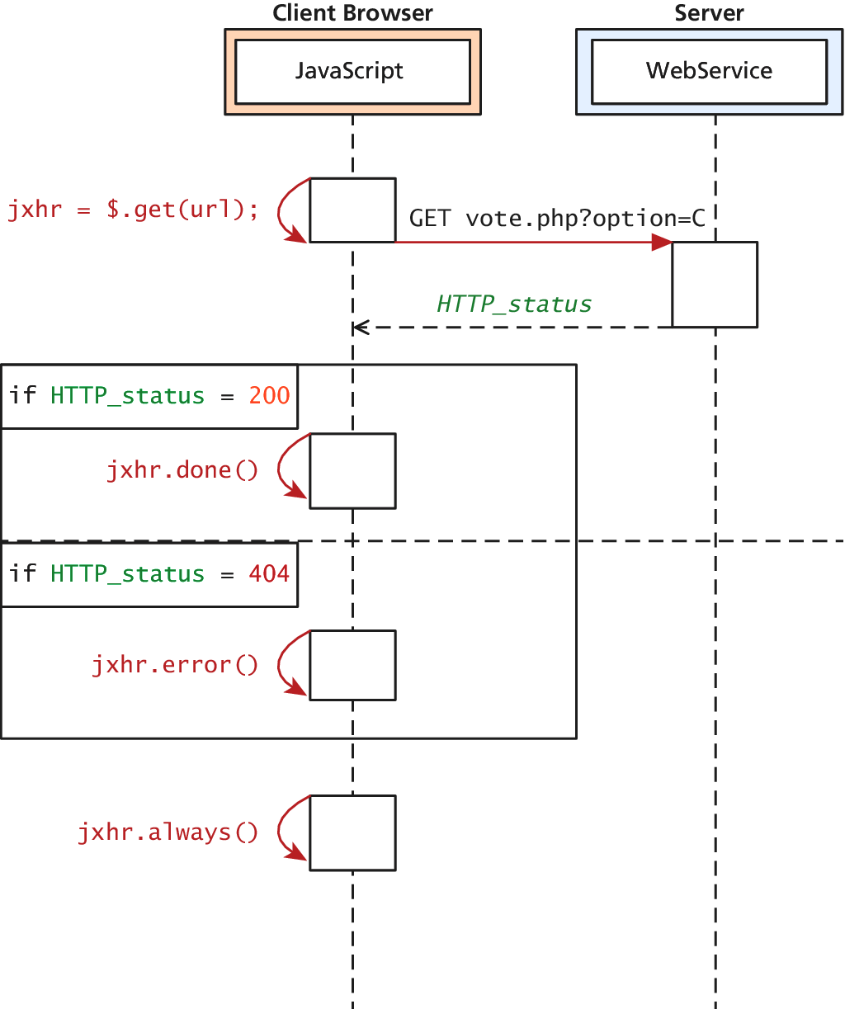
jqXHR
Actually quite easy to use
jqXHR objects have methods
done()
fail()
always()
which allow us to structure our code in a more modular way than the inline callback

Slide 62
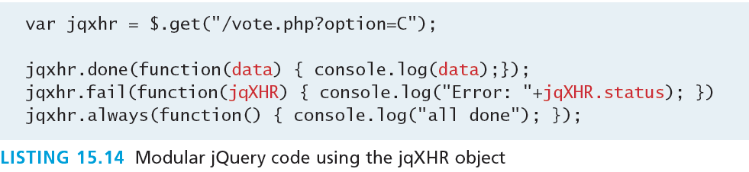
jqXHR
Very modular code

Slide 63
POST requests
Via jQuery AJAX
POST requests are often preferred to GET requests because one can post an unlimited amount of data, and because they do not generate viewable URLs for each action.
GET requests are typically not used when we have forms because of the messy URLs and that limitation on how much data we can transmit.
With POST it is possible to transmit files, something which is not possible with GET.

Slide 64
POST requests
Via jQuery AJAX
The HTTP 1.1 definition describes GET as a safe method meaning that they should not change anything, and should only read data.
POSTs on the other hand are not safe, and should be used whenever we are changing the state of our system (like casting a vote). get() method.
POST syntax is almost identical to GET.
jQuery.post ( url [, data ] [, success(data, textStatus, jqXHR) ] [, dataType ] )

Slide 65
POST requests
Via jQuery AJAX
If we were to convert our vote casting code it would simply change the first line from
var jqxhr = $.get("/vote.php?option=C");
to
var jqxhr = $.post("/vote.php", "option=C");

Slide 66
POST requests
Serialize() will seriously help
serialize() can be called on any form object to return its current key-value pairing as an & separated string, suitable for use with post().
var postData = $("#voteForm").serialize();
$.post("vote.php", postData);

Slide 67
Ajax
You have complete control
It turns out both the $.get() and $.post() methods are actually shorthand forms for the jQuery().ajax() method
The ajax() method has two versions. In the first it takes two parameters: a URL and a Plain Object, containing any of over 30 fields.
A second version with only one parameter is more commonly used, where the URL is but one of the key-value pairs in the Plain Object.

Slide 68
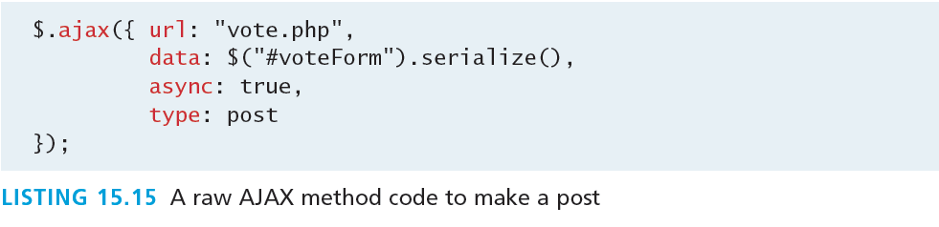
Ajax
More verbose
The one line required to post our form using get() becomes the more verbose code

Slide 69
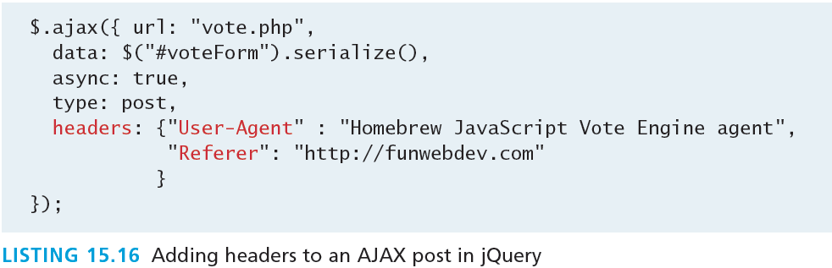
Ajax
You have complete control
To pass HTTP headers to the ajax() method, you enclose as many as you would like in a Plain Object. To illustrate how you could override User-Agent and Referer headers in the POST

Slide 70
CORS
Cross Origin Resource Sharing
Since modern browsers prevent cross-origin requests by default (which is good for security), sharing content legitimately between two domains becomes harder.
Cross-origin resource sharing (CORS) uses new headers in the HTML5 standard implemented in most new browsers.
If a site wants to allow any domain to access its content through JavaScript, it would add the following header to all of its responses.
Access-Control-Allow-Origin: *

Slide 71
CORS
Cross Origin Resource Sharing
A better usage is to specify specific domains that are allowed, rather than cast the gates open to each and every domain. To allow our domain to make cross site requests we would add the header:
Access-Control-Allow-Origin: www.funwebdev.com
Rather than the wildcard *.

Slide 72
Asynchronous File Transmission
Section 4 of 6

Slide 73
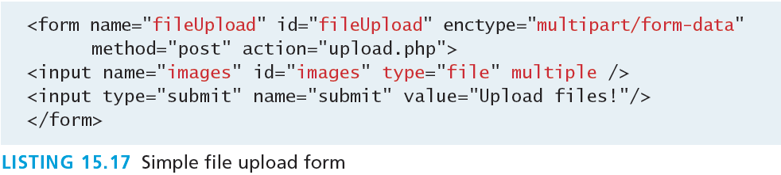
Asynchronous File Transmission
A Primer
Consider a simple form as defined below:

Slide 74
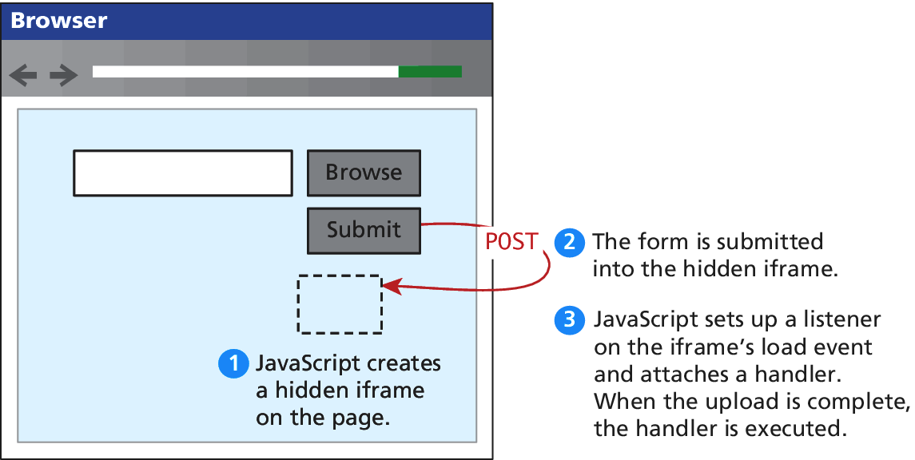
Asynchronous File Transmission
The old iFrame technique
The original workaround to allow the asynchronous posting of files was to use a hidden <iframe> element to receive the posted files.

Slide 75
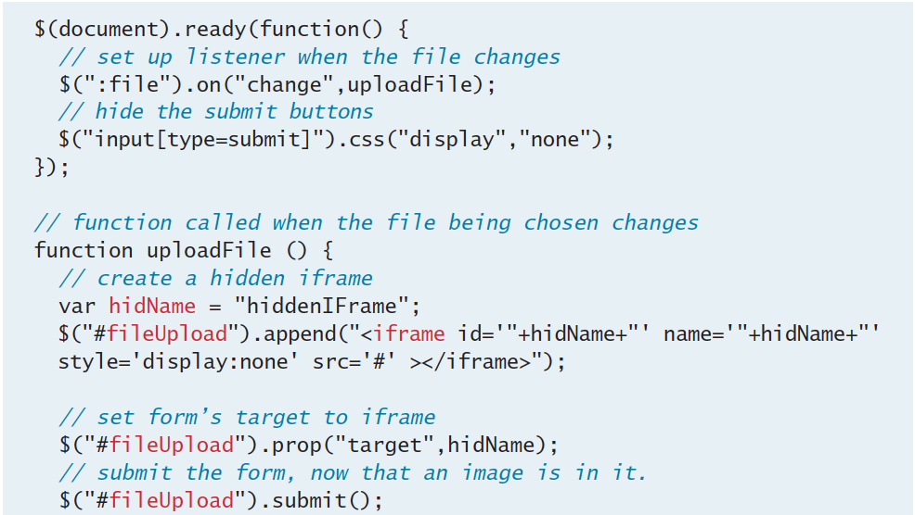
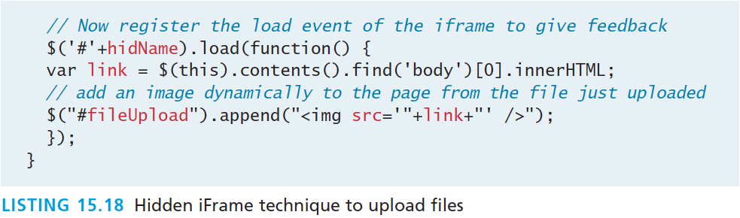
Asynchronous File Transmission
The old iFrame technique

Slide 76
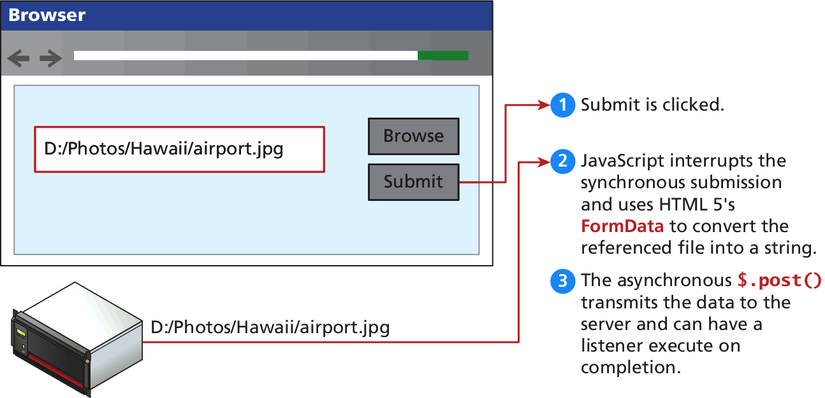
Asynchronous File Transmission
New Form Data technique
Using the FormData interface and File API, which is part of HTML5, you no longer have to trick the browser into posting your file data asynchronously.

Slide 77
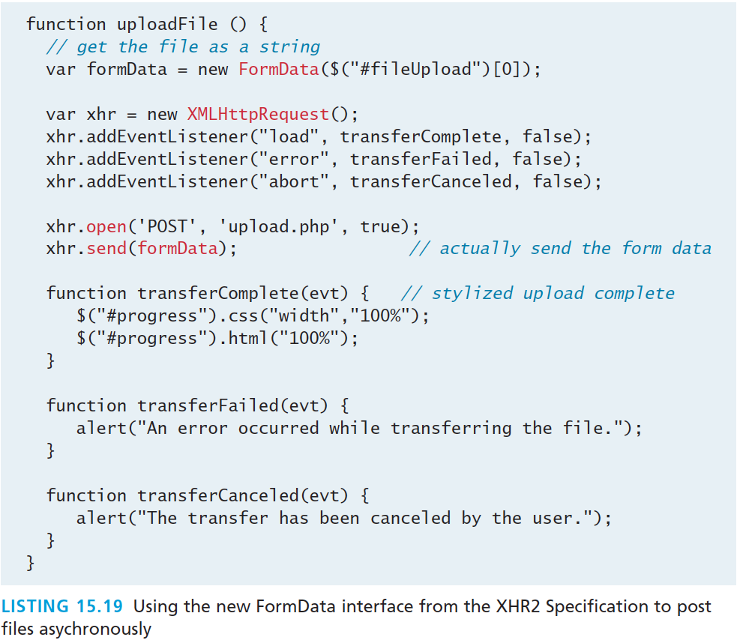
Asynchronous File Transmission
New Form Data technique

Slide 78
Asynchronous File Transmission
Advanced modern technique
When we consider uploading multiple files, you may want to upload a single file, rather than the entire form every time. To support that pattern, you can access a single file and post it by appending the raw file to a FormData object.
The advantage of this technique is that you submit each file to the server asynchronously as the user changes it; and it allows multiple files to be transmitted at once.

Slide 79
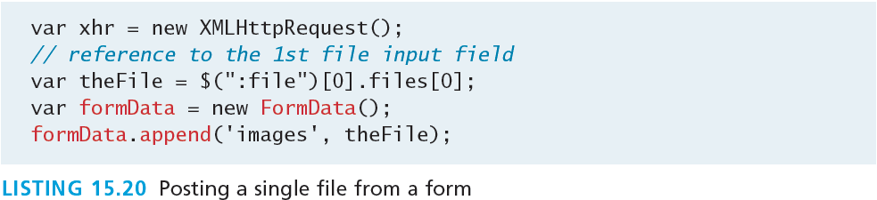
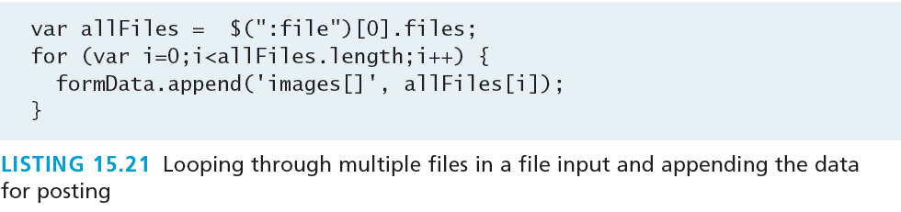
Asynchronous File Transmission
Advanced modern technique

Slide 80
Animation
Section 5 of 6

Slide 81
Animation
Hide() and Show()
The hide() and show() methods can be called with no arguments to perform a default animation. Another version allows two parameters: the duration of the animation (in milliseconds) and a callback method to execute on completion.

Slide 82
Animation
fadeIn() and fadeOut()
The fadeIn() and fadeOut() shortcut methods control the opacity of an element. The parameters passed are the duration and the callback, just like hide() and show(). Unlike hide() and show(), there is no scaling of the element, just strictly control over the transparency.

Slide 83
Animation
SlideUp() and SlideDown()
slideUp() and slideDown() do not touch the opacity of an element, but rather gradually change its height.
email icon from http://openiconlibrary.sourceforge.net.

Slide 84
Animation
Toggle()
As you may have seen, the shortcut methods come in pairs, which make them ideal for toggling between a shown and hidden state. Using a toggle method means you don’t have to check the current state and then conditionally call one of the two methods;
To toggle between the visible and hidden states you can use the toggle() methods.
To toggle between fading in and fading out, use the fadeToggle() method
To toggle between the two sliding states can be achieved using the slideToggle() method.

Slide 85
Raw Animation
Full control
The animate() method has several versions, but the one we will look at has the following form:
.animate( properties, options );
The properties parameter contains a Plain Object with all the CSS styles of the final state of the animation.
The options parameter contains another Plain Object with any of the following options set:

Slide 86
Raw Animation
Options parameter
always is the function to be called when the animation completes or stops with a fail condition. This function will always be called (hence the name).
done is a function to be called when the animation completes.
duration is a number controlling the duration of the animation.
fail is the function called if the animation does not complete.
progress is a function to be called after each step of the animation.

Slide 87
Raw Animation
Options parameter
queue is a Boolean value telling the animation whether to wait in the queue of animations or not. If false, the animation begins immediately.
step is a function you can define that will be called periodically while the animation is still going.
Advanced options called easing and specialEasing allow for advanced control over the speed of animation.

Slide 88
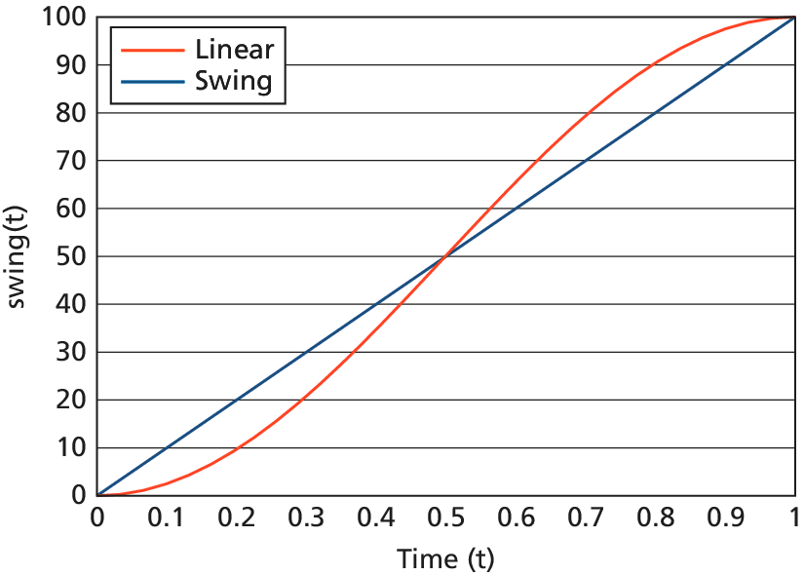
Raw Animation
Easing functions – advanced animation
In web development, easing functions are used to simulate that natural type of movement. They are mathematical equations that describe how fast or slow the transitions occur at various points during the animation.
Included in jQuery are
linear
swing
easing functions.

Slide 89
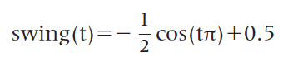
Raw Animation
Easing functions – advanced animation
For example, the function defining swing for values of time t between 0 and 1 is
The jQuery UI extension provides over 30 easing functions, including cubic functions and bouncing effects, so you should not have to define your own.

Slide 90
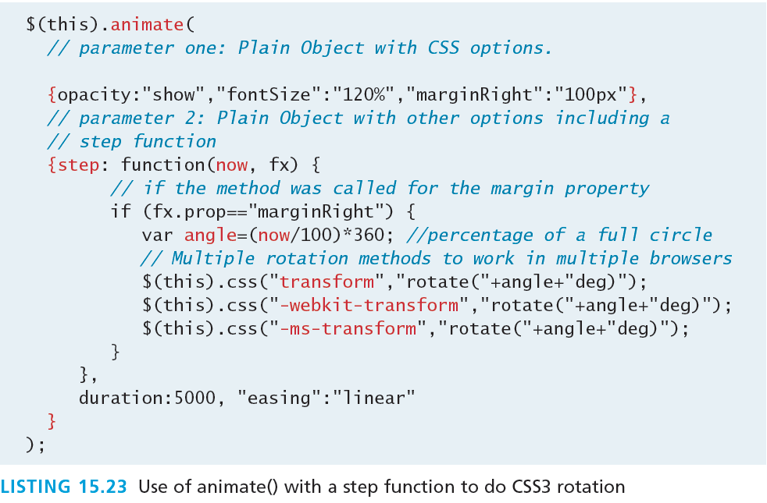
Advanced example
rotating

Slide 91
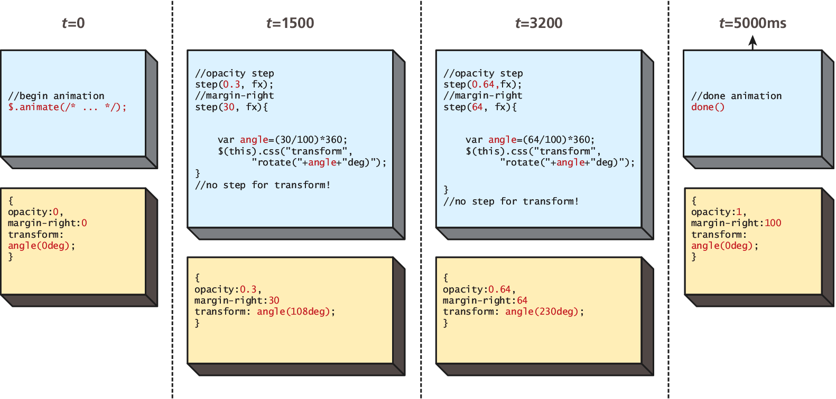
Raw Animation
Rotating

Slide 92
BackBone MVC Frameworks
Section 6 of 6

Slide 93
Backbone
Another framework
Backbone is an MVC framework that further abstracts JavaScript with libraries intended to adhere more closely to the MVC model
This library is available from http://backbonejs.org and relies on the underscore library, available from http://underscorejs.org/.
Include with:
<script src="underscore-min.js"></script>
<script src="backbone-min.js"></script>

Slide 94
Backbone
Models
In Backbone, you build your client scripts around the concept of models.
Backbone.js defines models as
the heart of any JavaScript application, containing the interactive data as well as a large part of the logic surrounding it: conversions, validations, computed properties, and access control.
The Models you define using Backbone must extend Backbone.Model

Slide 95
Backbone
Collections
In addition to models, Backbone introduces the concept of Collections, which are normally used to contain lists of Model objects.
These collections have advanced features and like a database can have indexes to improve search performance.
A collection is defined by extending from Backbone’s Collection object.

Slide 96
Backbone
Views
Views allow you to translate your models into the HTML that is seen by the users.
They attach themselves to methods and properties of the Collection and define methods that will be called whenever Backbone determines the view needs refreshing.
You must always override the render() method since it defines the HTML that is output.

Slide 97
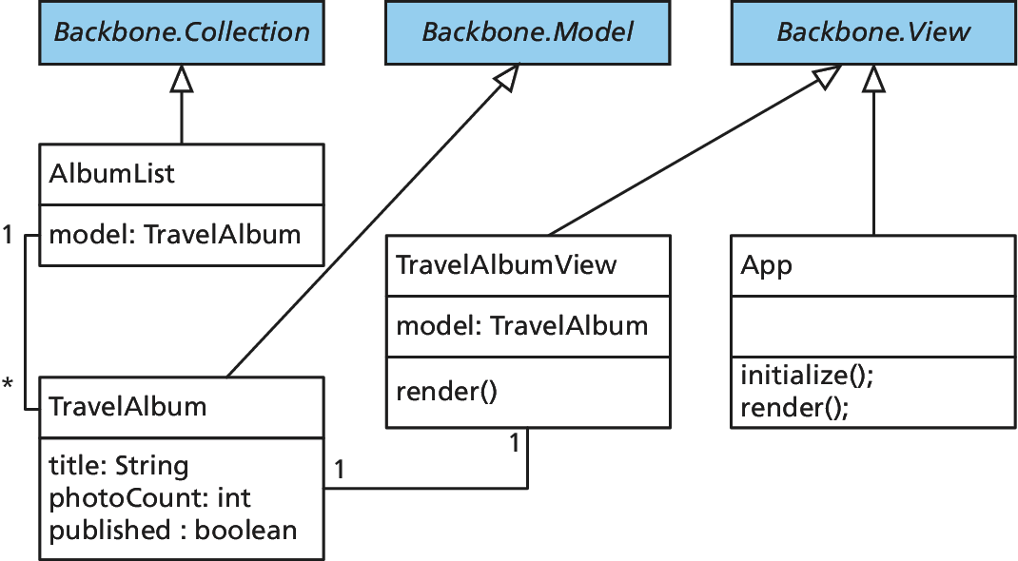
Backbone
Example

Slide 98
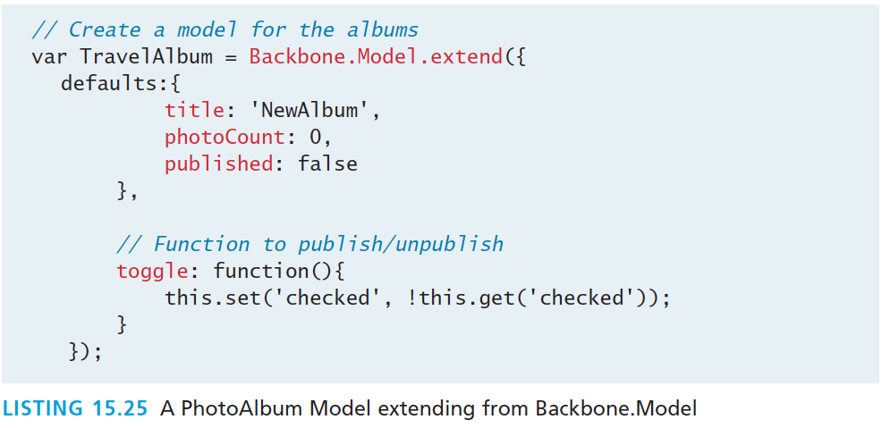
Backbone
A Model Example

Slide 99
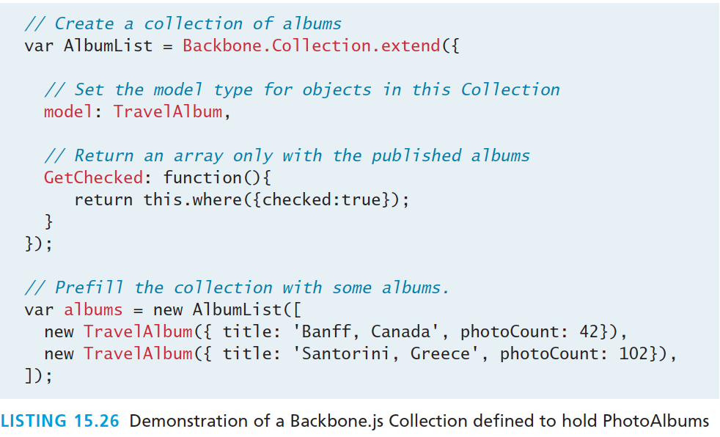
Backbone
A Collection Example

Slide 100
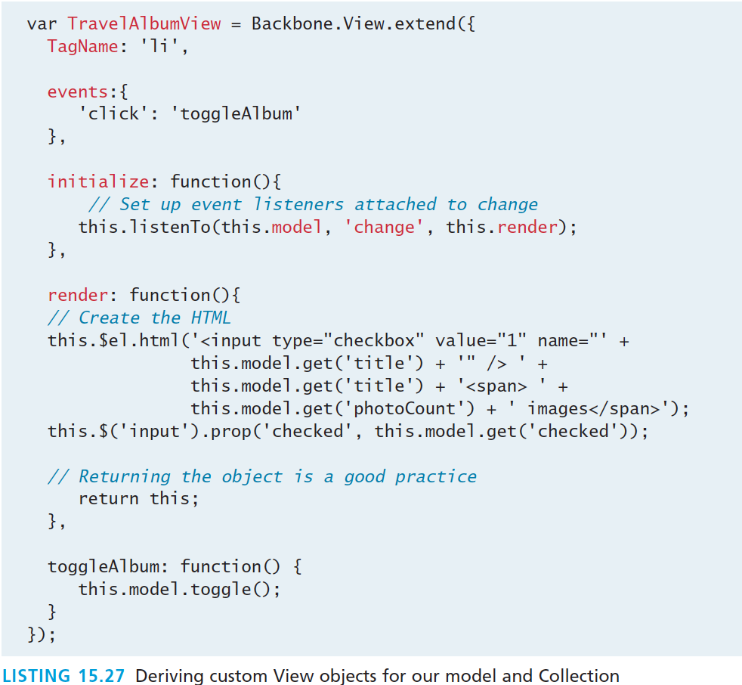
Backbone
A View Example

Slide 101
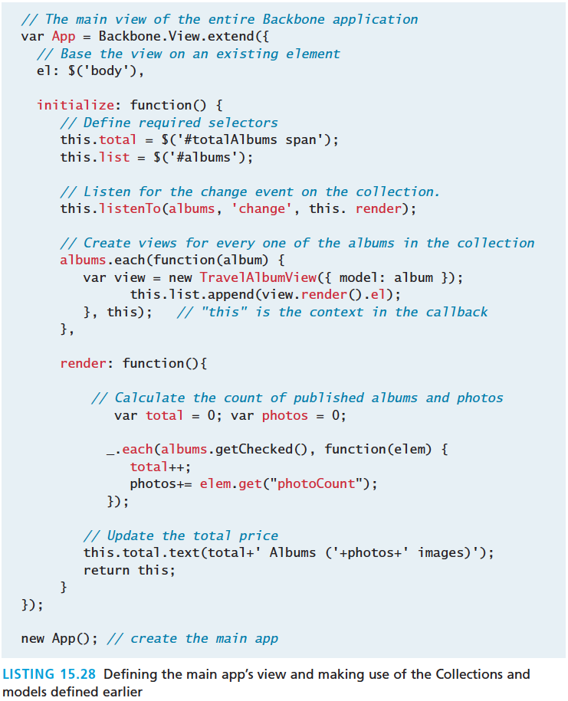
Backbone
Bring it all together

Slide 102
What You’ve Learned
1
2
JavaScript Pseudo-Classes
jQuery Foundations
3
4
AJAX
Asynchronous File Transmission
5
6
Animation
Backbone MVC Frameworks
7

